Slide 1

Business Intelligence Project
SALES DASHBOARD
Presented By:
Aresha Arshad
Reeha Khan
Aimen Khan

Slide 2

Data set:
The dataset contains 4 tables:
Sales Orders – contains details of each sale.
Customers – contains the customer names.
Regions – contains the addresses.
Products – contains the names of all products.

Slide 3

ETL

Slide 4
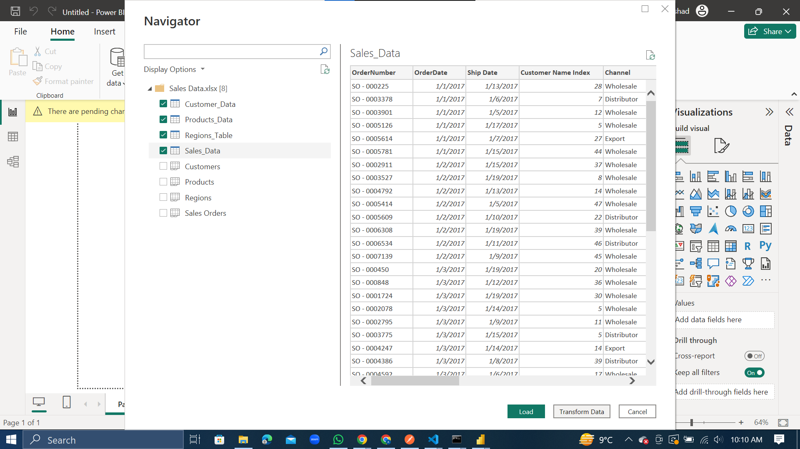

Slide 5
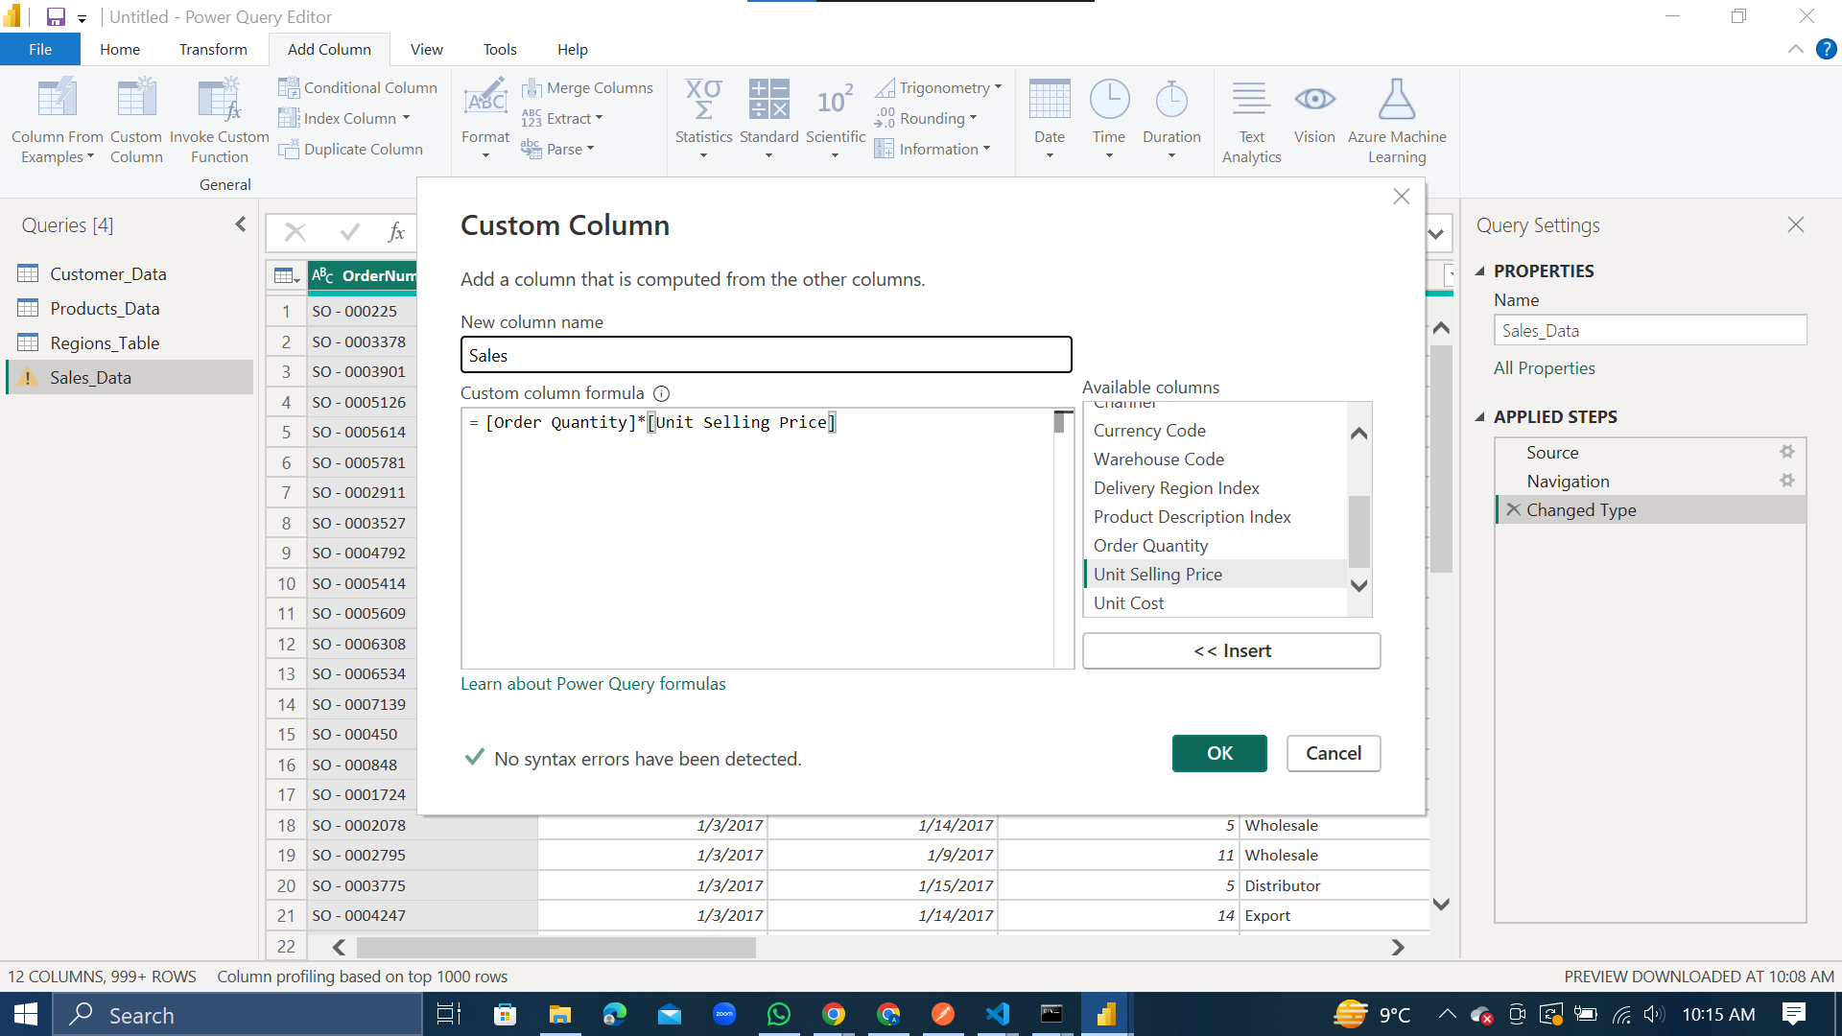

Slide 6
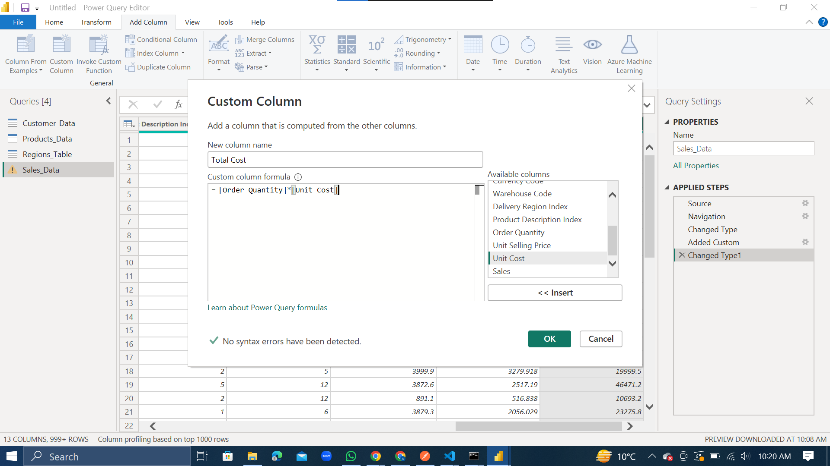

Slide 7
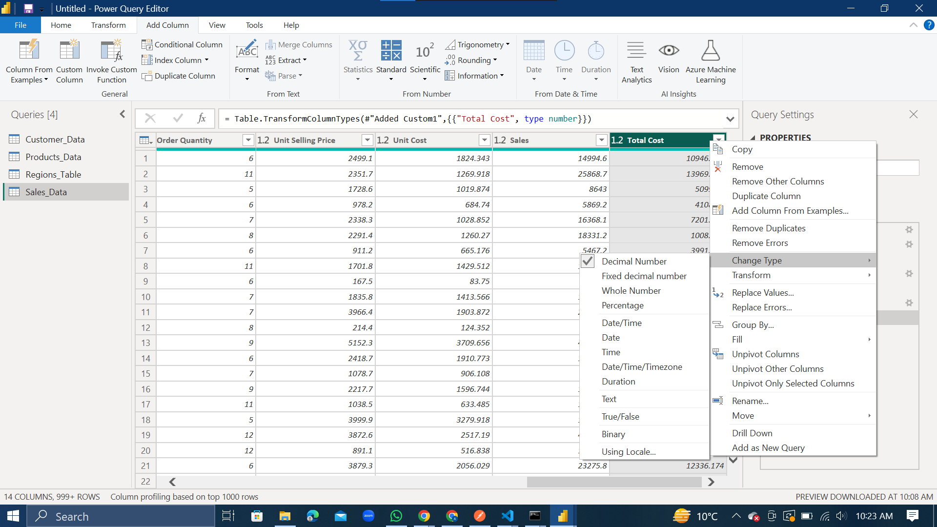

Slide 8
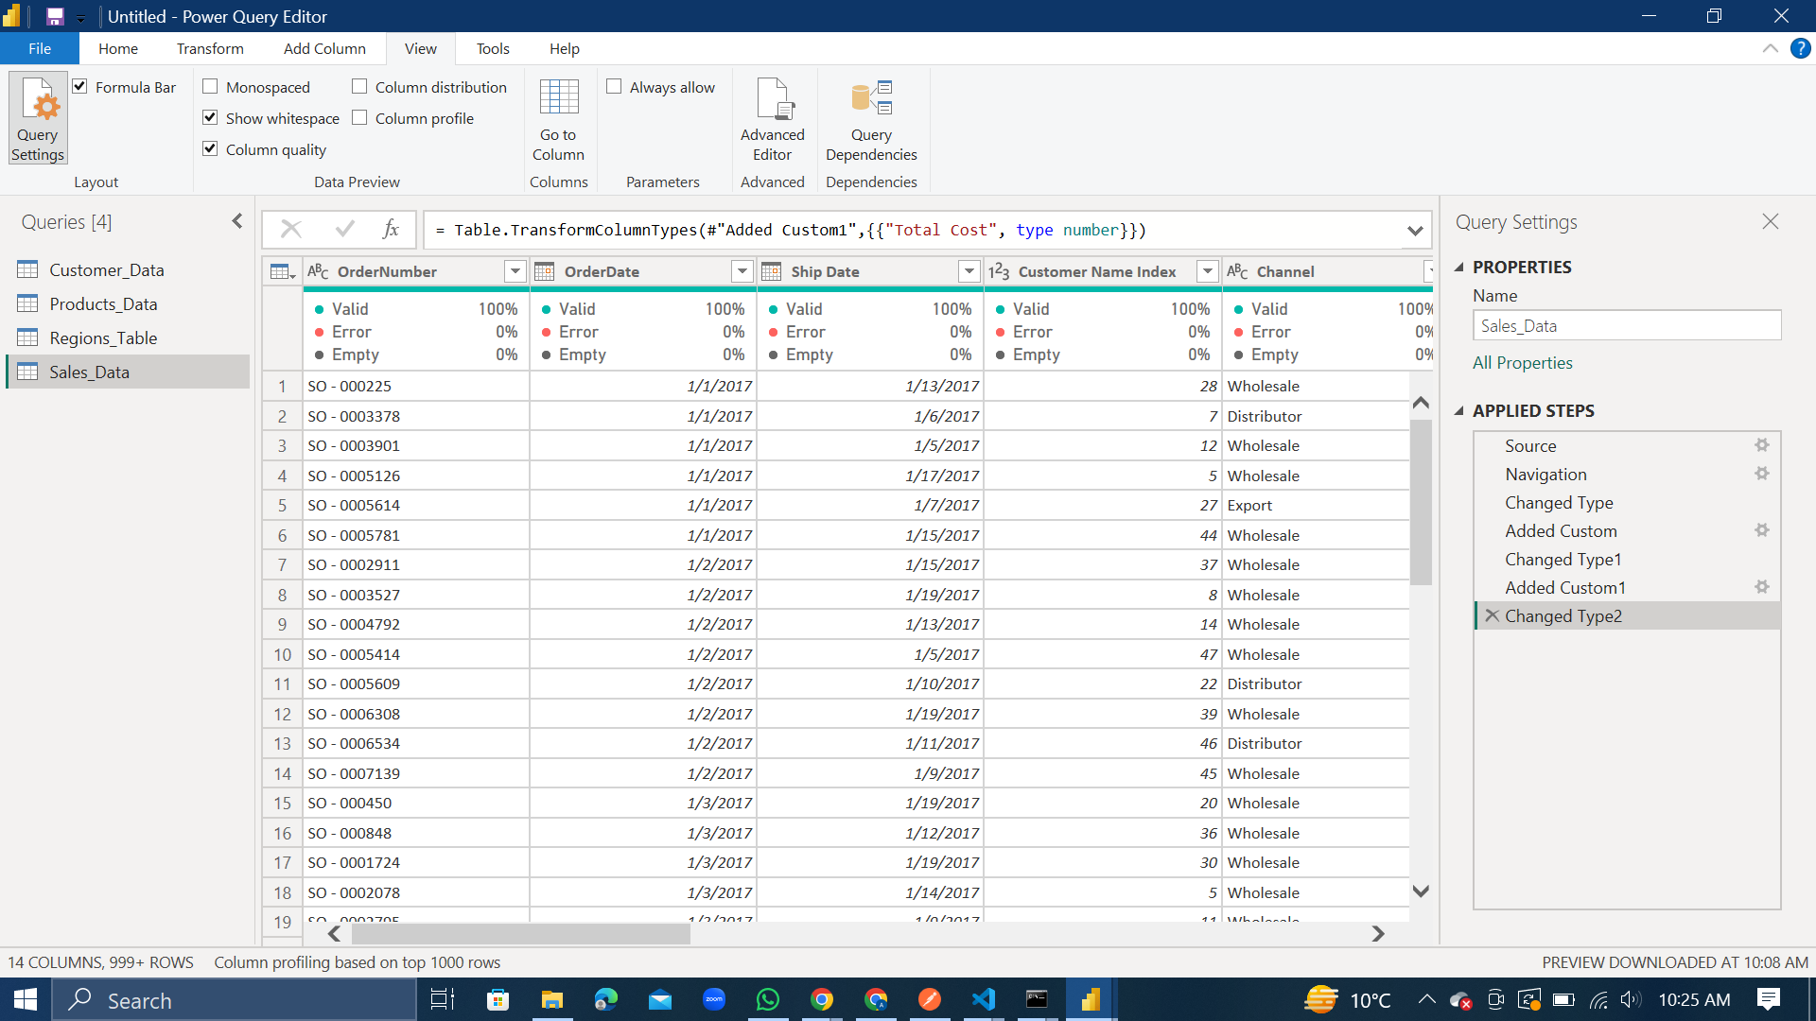

Slide 9
Data Analysis Expressions (DAX)

Slide 10
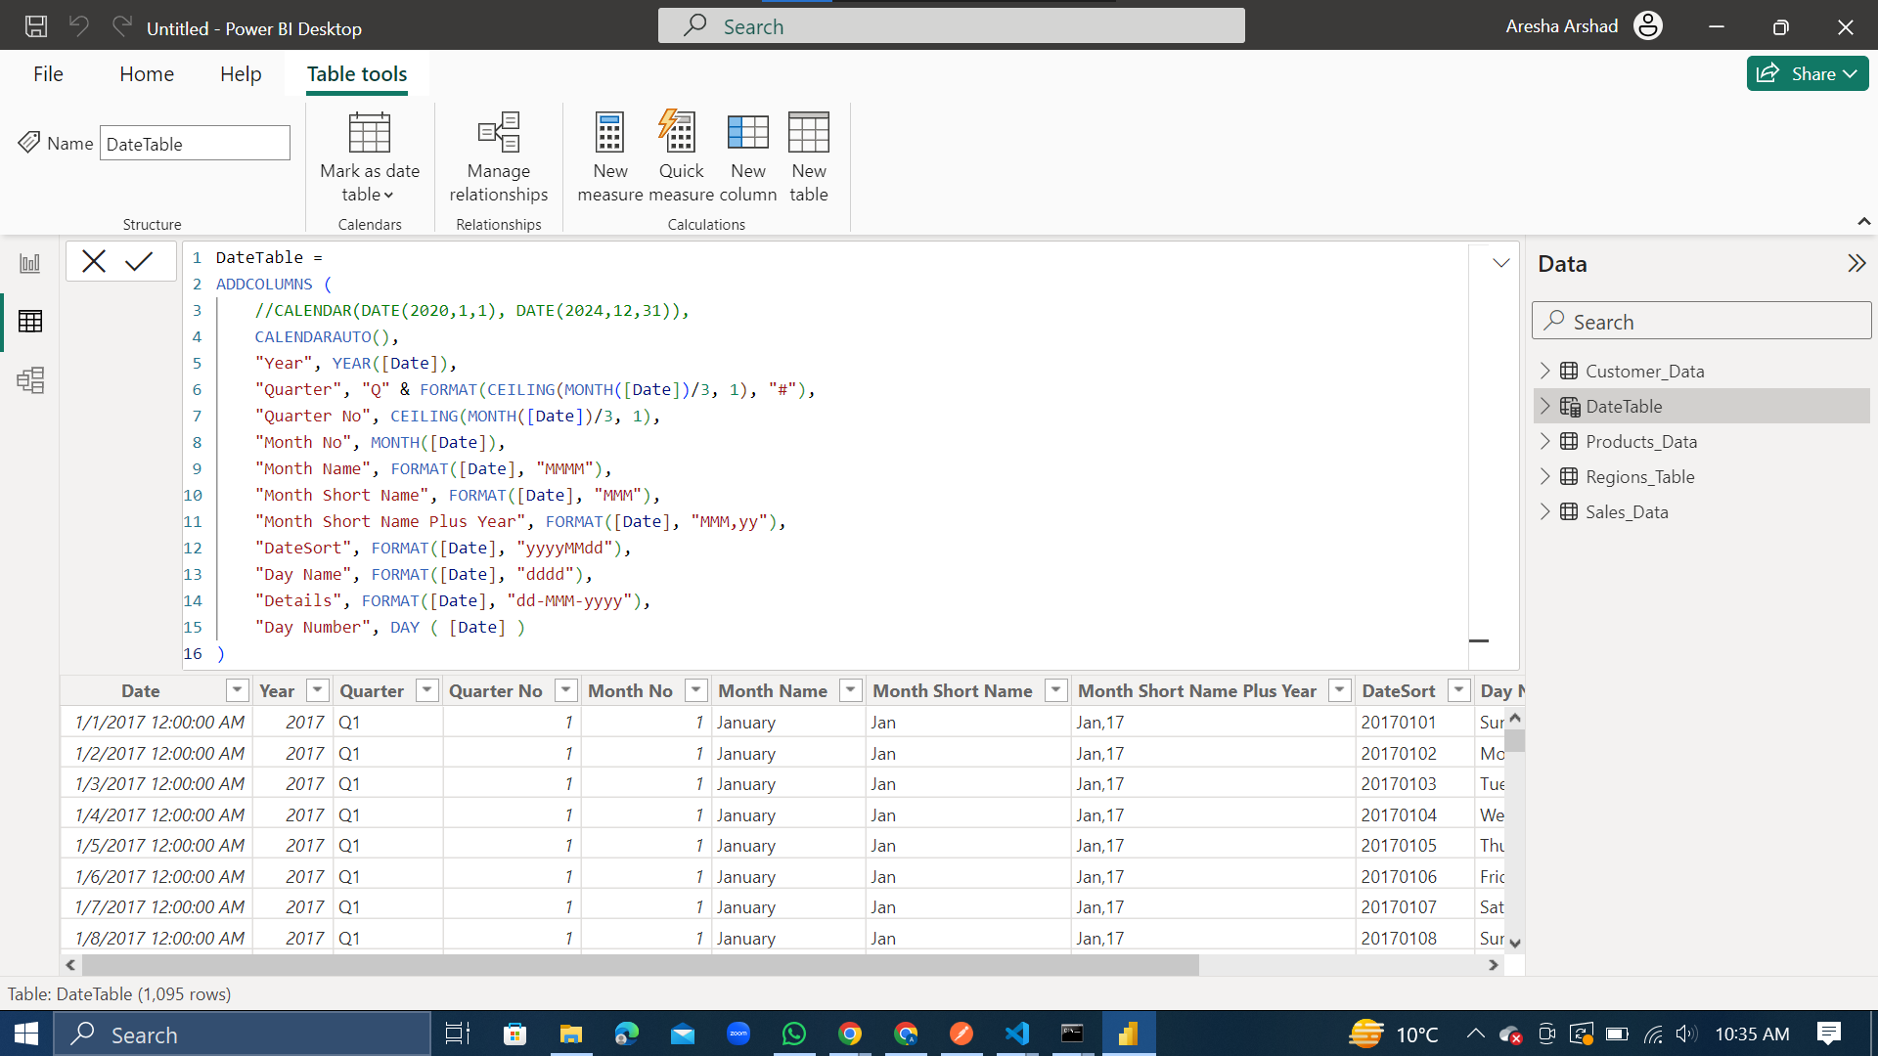

Slide 11

Data Modeling

Slide 12
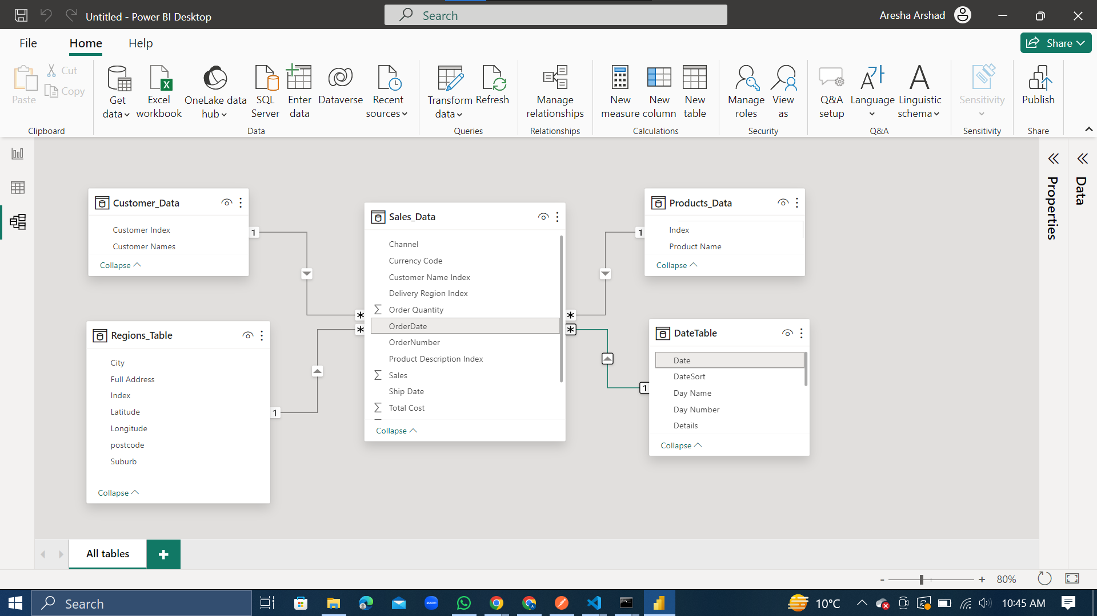
Choose of the Schema
Select Data & Regions table
Sales Data & Customer Data
Sales Data Table & Products Data Table
Sales Data Table & Date Table

Slide 13
MEASURES

Slide 14
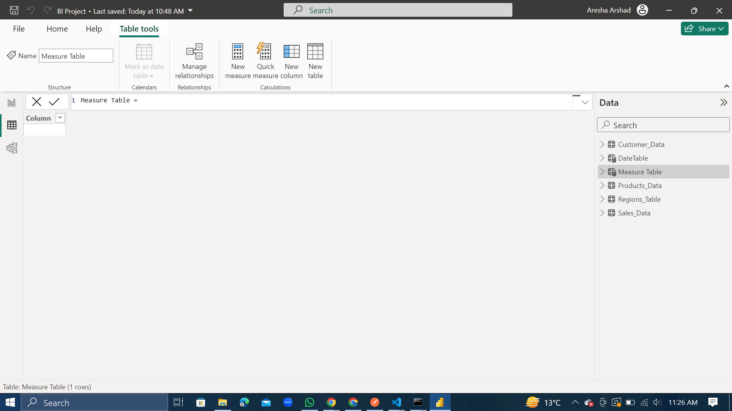

Slide 15
Sales
Sales PY
Sales vs PY
Sales Vs PY %
Profit
Products Sold
Profit Margin
Profit LY
Profit Vs. LY
Profit Vs. LY %

Slide 16
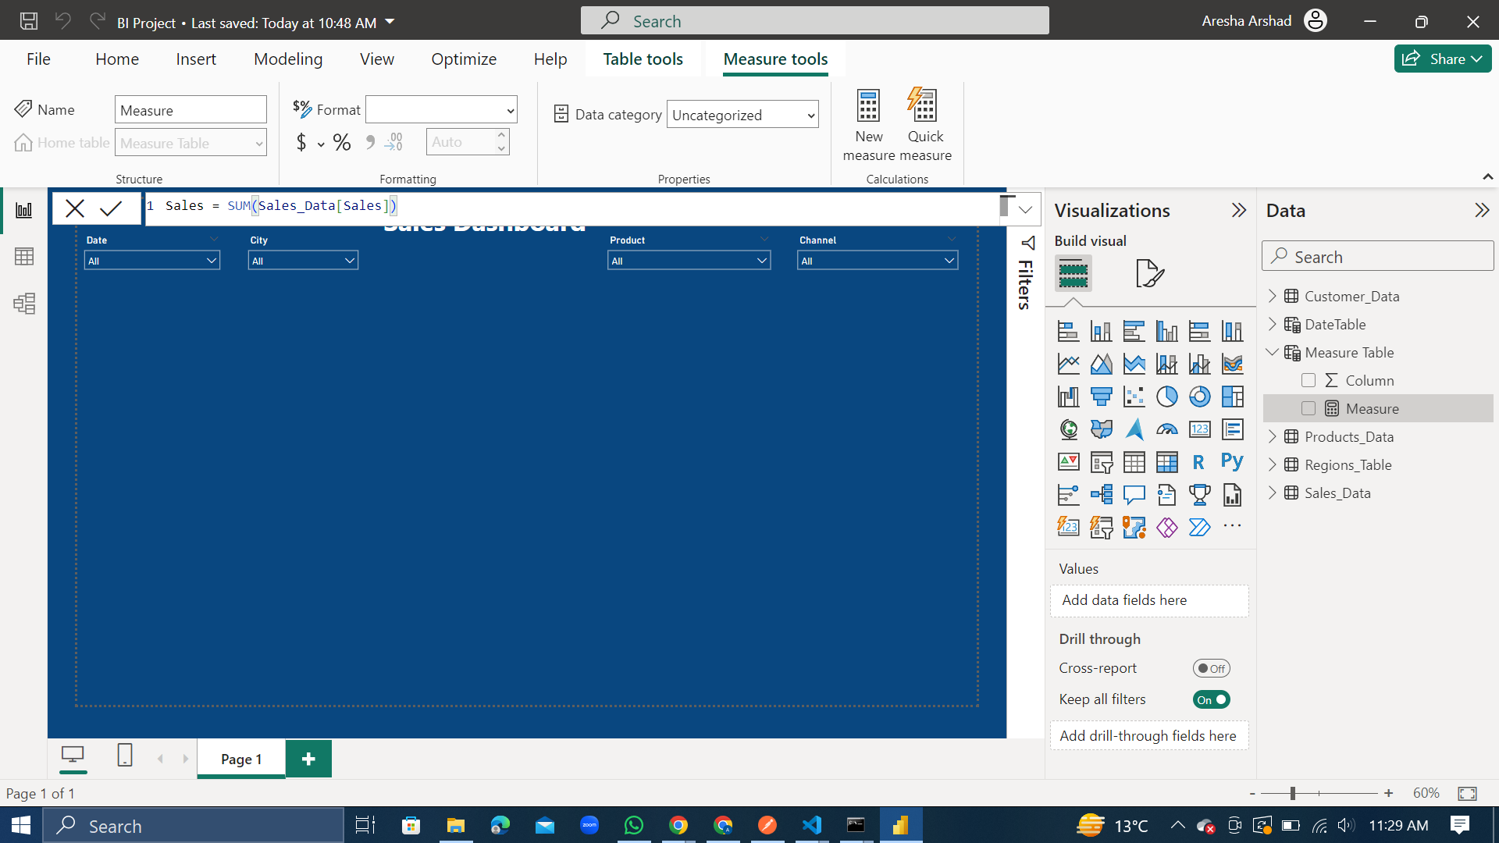
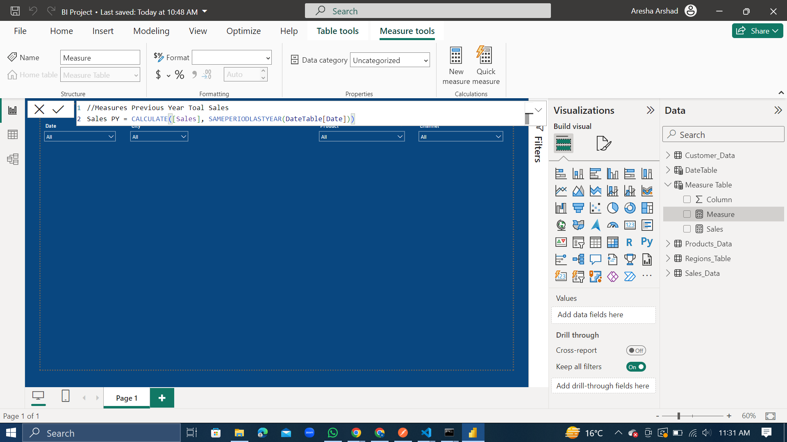

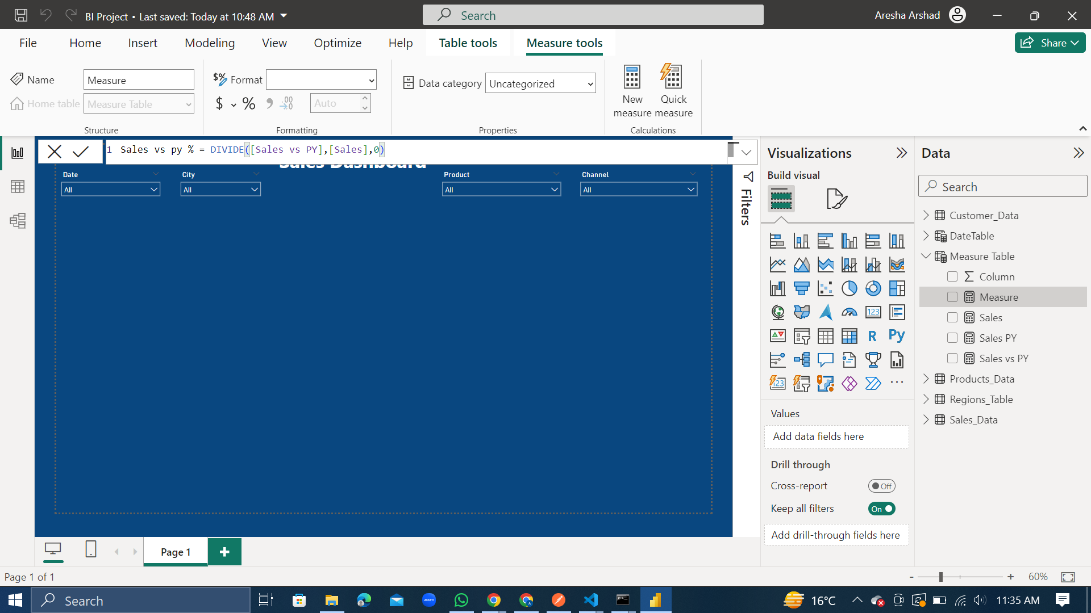
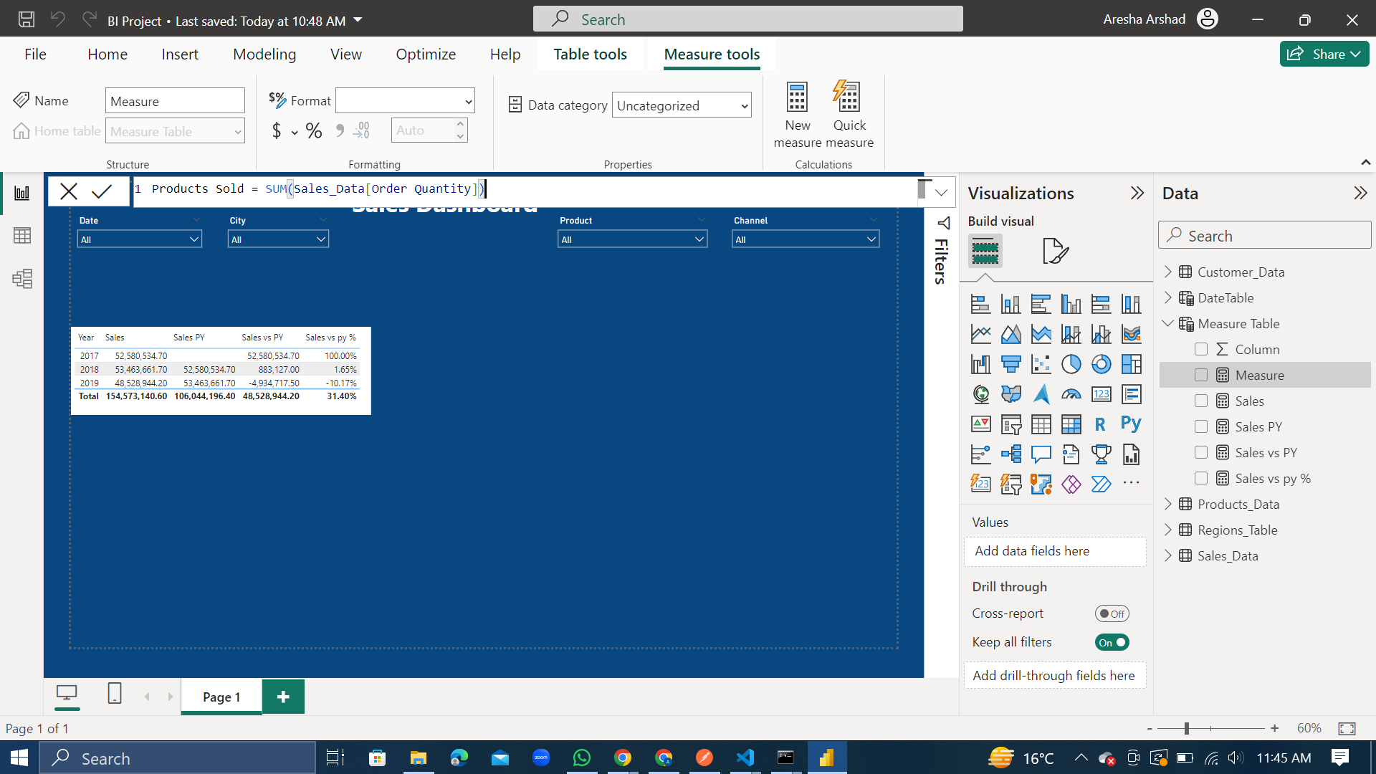


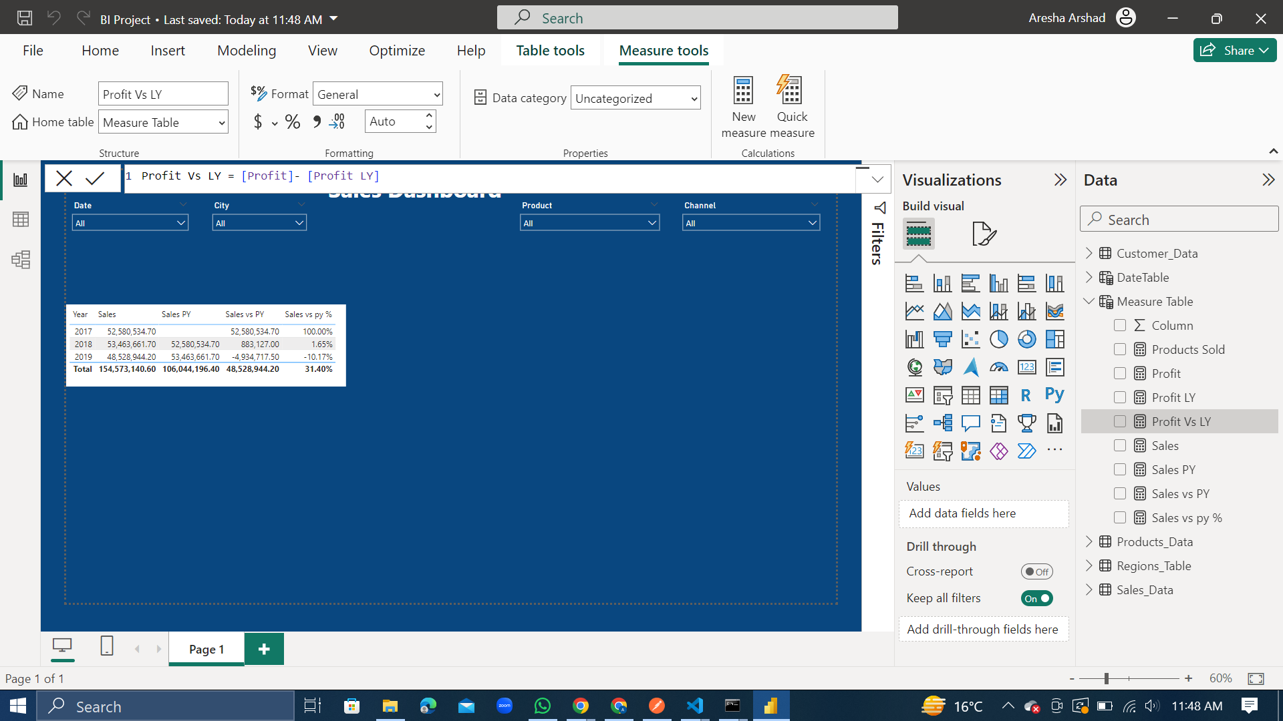

Slide 17


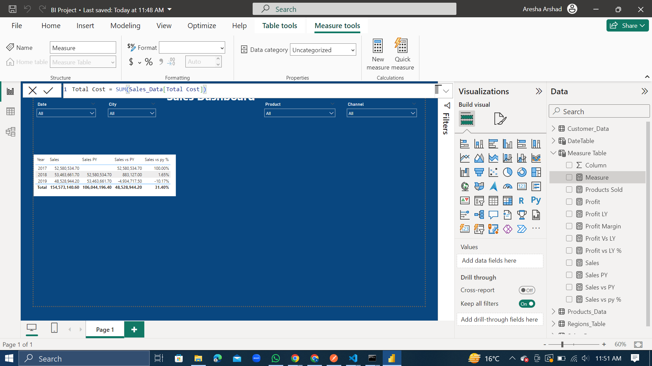

Slide 18

VISUALIZATIONS
and INSIGHTS

Slide 19
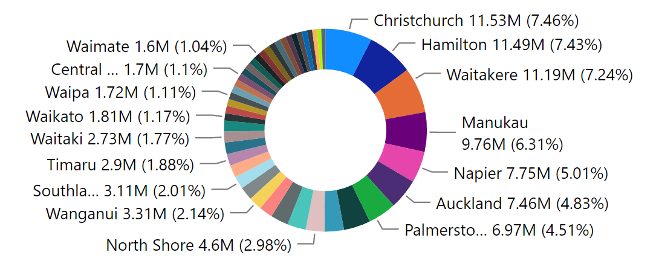
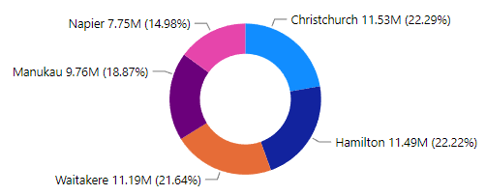
Sales By City
Many cities have less than 1.5% share in the sales.
The top 5 cities with the highest sales are considered in the pie chart.
Christchurch, Hamilton and Waitakere are the cities with the highest sales (almost 22% for each).

Slide 20
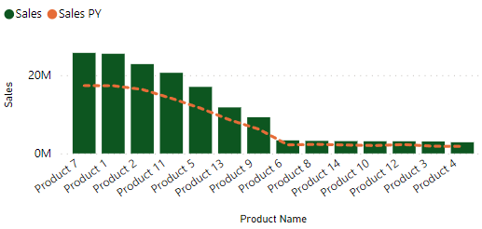
Current Year Sales and Previous Year Sales per Product
﻿At 25M, Product 7 had the highest Sales and was 799.81% higher than Product 4, which had the lowest Sales at 2M.﻿
﻿Product 7 accounted for 16.63% of Sales.﻿
﻿Sales and Sales PY are positively correlated with each other.﻿
﻿Second highest sales are of Product 1 which is not much lower than Product 7.
Products 6,8,14,10,12,3 and, 4 produce the least number of sales.

Slide 21
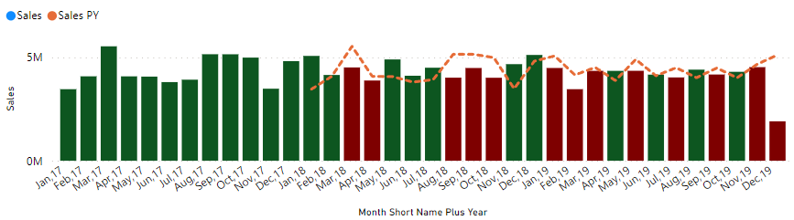
Current Year Sales vs Previous Year Sales per Month
The highest sales (5M) are in March 2017 which were 190.2% higher than that of December 2019, which had the lowest Sales (1M).﻿﻿
﻿﻿Mar 2017 accounted for 3.58% of Sales.﻿﻿
﻿﻿Sales and Sales PY are positively correlated with each other.﻿﻿
Sales PY and Sales diverged the most when in December 2019, when Sales PY were 3M higher than Total Sales.﻿﻿
The Sales of the Previous Year are higher in the March, April, August, September, and October of 2018 along with January, February, March, May, July, September, November and December of 2019.

Slide 22
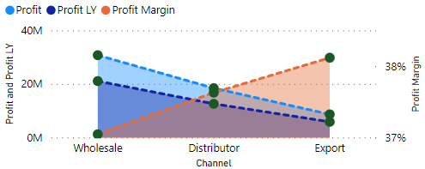
Total Profit, Profit Last Year, and Profit Margin per Channel
﻿At around 30M, Wholesale had the highest Profit and was 256.20% higher than Export, which had the lowest Profit at around 8M.﻿
﻿Profit and Profit LY are positively correlated with each other.﻿
﻿Wholesale accounted for 53.18% of Profit.﻿
Distributor and Export combined accounted for 47% of Profit.
﻿Wholesale had 30M Profit, 21M Profit LY, and 37.04% Profit Margin.
Distributor had 18M Profit, 12M Profit LY, and 37.63% Profit Margin.
Export had 8M Profit, 5M Profit LY, and 38.12% Profit Margin.﻿

Slide 23
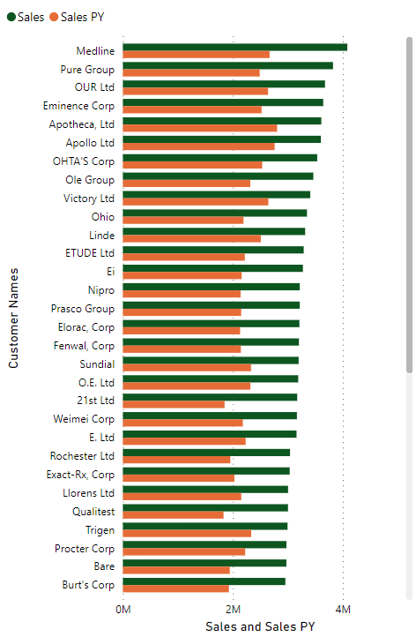
Current Year Sales vs Previous Year Sales per Customer Names
At 4M, Medline had the highest Sales and was 72.58% higher than WakeFern, which had the lowest Sales at 2.4M.﻿
﻿Medline accounted for 2.64% of Sales.﻿
Sales and total Sales PY are positively correlated with each other.
Current Years Sales increased the most than Previous Year Sales PY when the Customer Names was Medline. The difference was 1.4M.﻿
There are 0 customers where the Sales PY are higher than Sales this year.
The least increase in Sales from the Previous Year was for the Customer 3Lab, Ltd.

Slide 24

Issues Identified
Sales of Products 6,8,14,10,12,3 and, 4 are very low across every year.
Many cities which have less than 1% share in the sales.
December 2019 produced a significant decrease in Sales.
Wholesale products account for 53% of the profits, so there is a need to focus more on the Distributor and Export.
There is a need to focus on the Customer 3Lab, Ltd as they have produced the least increase in sales from the previous year.

Slide 25




Key Performance Indicators
Profit
57.79M
Products Sold
68K
Sales
154.7M
Profit Margin
37.39%

Slide 26

DASHBOARD LAYOUT

Slide 27
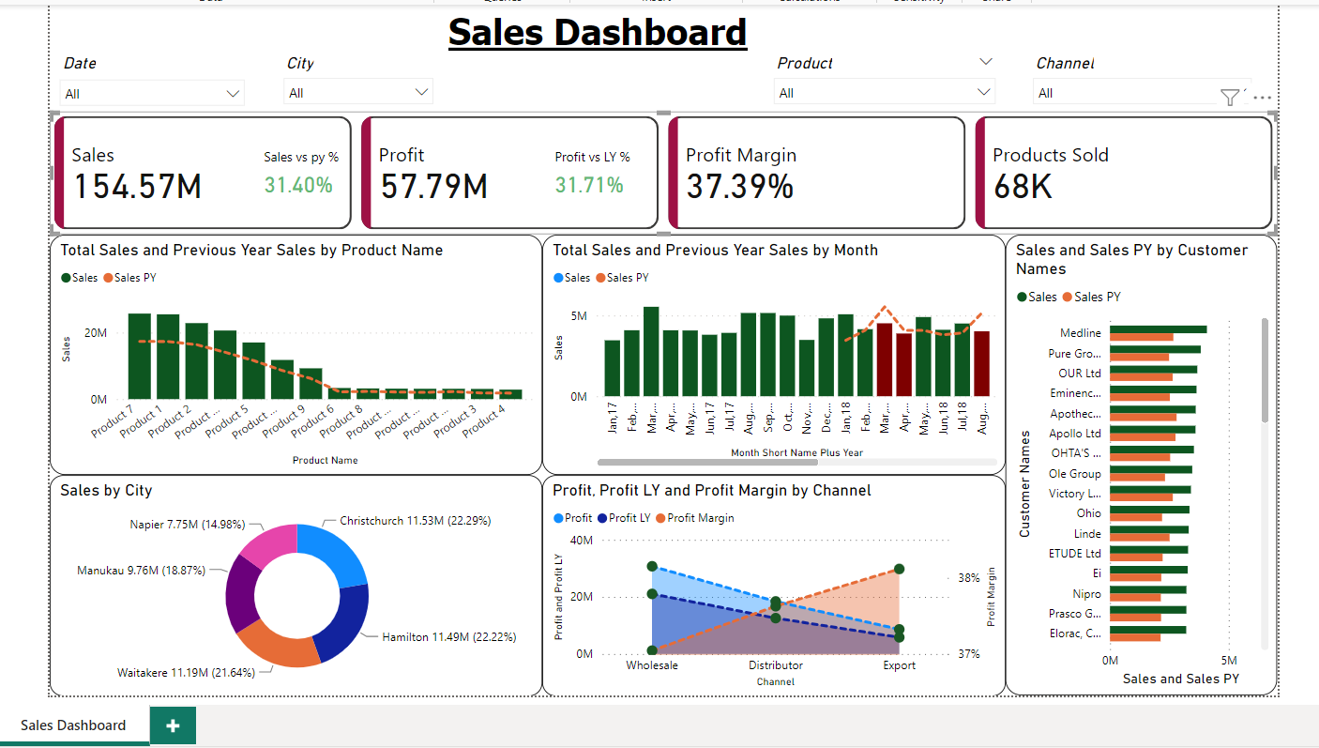


Slide 28


